Slide 1
BHSN Girl’s Soccer 2020 Call Out
Coach Jeff Thomas
May 11, 2020, 11AM

Slide 2
Overview of Today’s call
1. Introduce the Coaches
2. Tell you what we know about season starting
3. What should a player do this summer?
4. Get you connected via GroupMe (players), TeamSnap (parents) and Twitter (all)
5. What’s my vision for this program (if time)
6. Your questions.
7. Next?

Slide 3
Coaches for 2020 Season Varsity: Jeff Thomas
Cutters: 05 Boys & 08 Boys (Current), 04 Boys & 07 Boys (2018/19)
5 years in Australia (2013-2018)
Indiana State ODP Team U17 Girls 2012 , 2013
IUWS Vol. Assistant 2011, IUWCS Head Coach 2012
Cutters 02 Girls (2011-13), 97 Girls (2009-11), 98 Boys (2007-08), 92 Boys (2007-09)
BHSS Girls Vol. Assistant (2009), JV Coach (2010)
Played for Claudelands Rovers AFC, in Hamilton, NZ
Email thomasjbg@hotmail.com Cell 812 325 6386

Slide 4
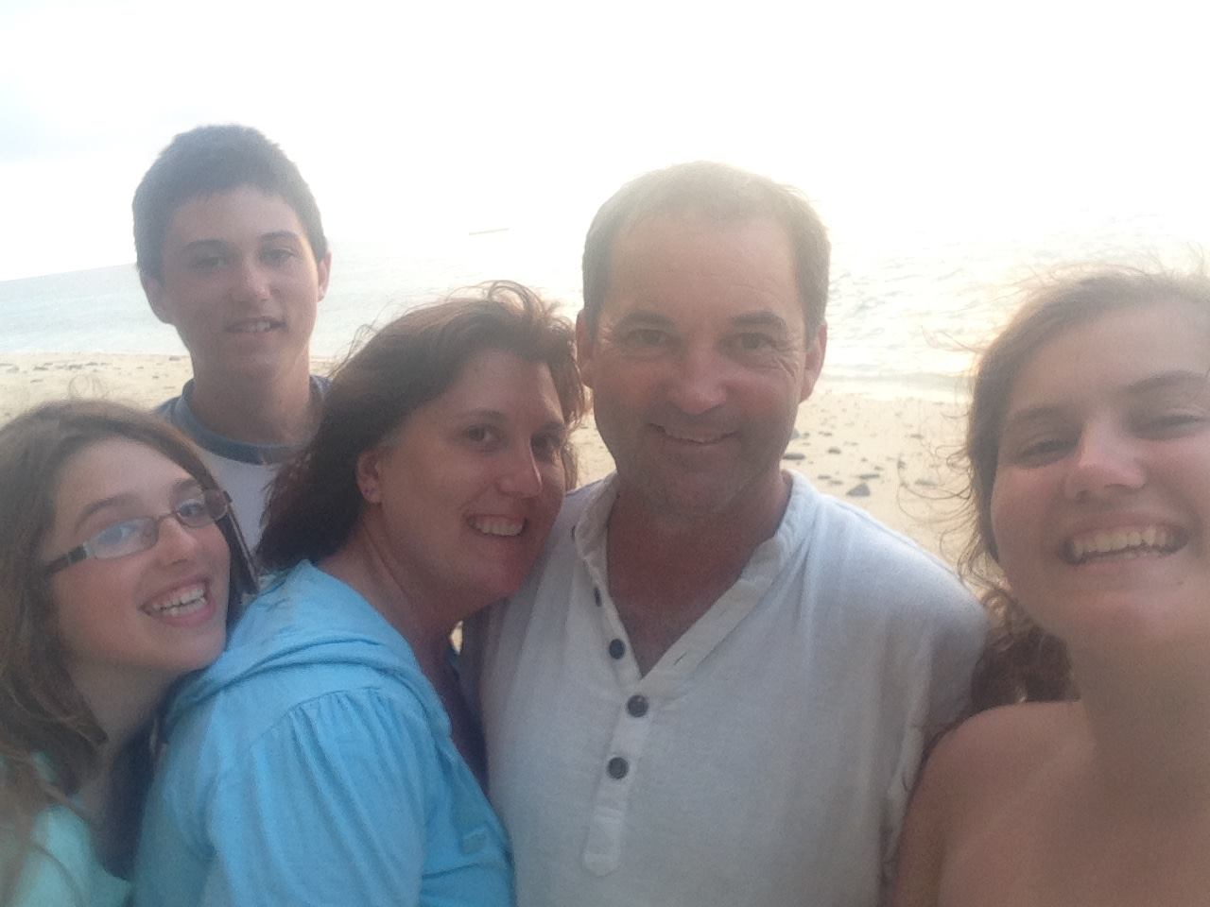
Education & Family
Morrinsville College -- High School (NZ)
Waikato Institute of Technology – Hamilton, NZ
University of Maryland, College Park MBA
Teaching at Georgetown University, University of
Maryland, Indiana University, Outward Bound USA
“Enthusiasm is everything. It must be taut and vibrating like a guitar string.” – Pelé

Slide 5
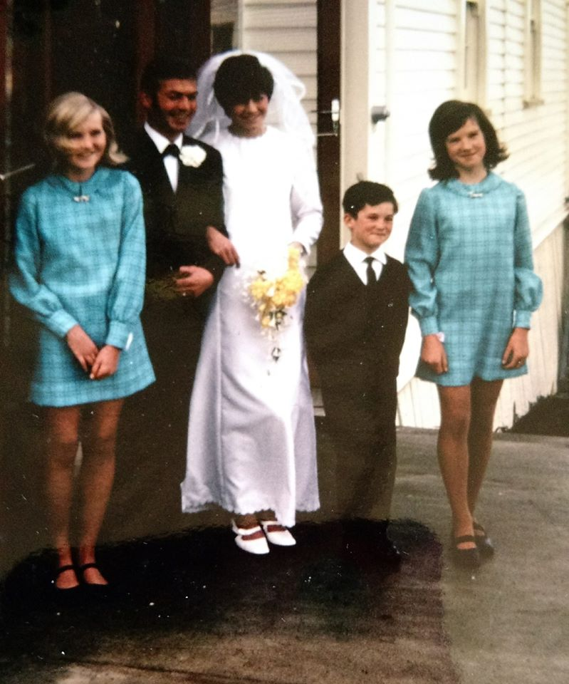
Education & Family
Morrinsville College -- High School (NZ)
Waikato Institute of Technology – Hamilton, NZ
University of Maryland, College Park MBA
Teaching at Georgetown University, University of
Maryland, Indiana University, Outward Bound USA Team of THOMAS: Mike (GK)
Sandy, Carole, Kay, Jeff
Rachel, Tasha, Victoria, Catherine
Ben, Isaac
“Jeff Thomas made lots of penetrating runs up the field, whenever he got the ball. Occasionally he’d pass it, too.“ Soccer Report, Morrinsville College Yearbook, Junior Year

Slide 6
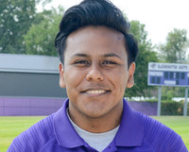
Coaches for 2020 Season JV Brandon Ledezma Flores
Graduated with Academic honors from Emmerich Manual High School
Senior at Indiana University Bloomington.
Major in Sport Marketing & Management with a minor in coaching
JV coach at Bloomington South last season
Has coached U-14 boys’ club soccer in Indianapolis.
Played at Emmerich Manual HS, Indianapolis

Slide 7
Other Roles for 2020 Season Watch this Space
One Coach to be added (preferably a former BHSN girls player)
Volunteer coach to be added
Student manager for 2020?
Parent volunteers: Kim Clarke (Lucy’s mom), Kimberley Martin (Lucy’s mom)

Slide 8
When Will the 2020 Season Start?
Not before May 15th (Monroe County Public Health Guidelines)
Not Before July 1st (IHSAA/State Dept of Education)
No Moratorium week (usually week of 4th July)
First unofficial Practices July 1st
First Official Practices August 3rd
First game scheduled August 16th

Slide 9
What Should I do? 1. Student Athlete Physicals
All 2019-20 physicals will be good for use during the 2020-21 school year
Any athlete that got a physical this past year will be covered for this upcoming season.
Mass physicals (BHSS/BHSN joint) have been cancelled
New players check BHSN Athletic Department for Guidance (but not yet!)
No physical = No play
https://bloomingtonnorthathletics.com/

Slide 10
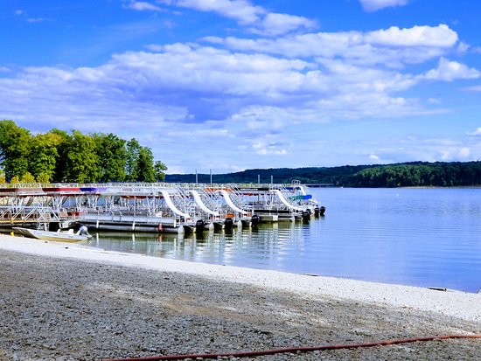
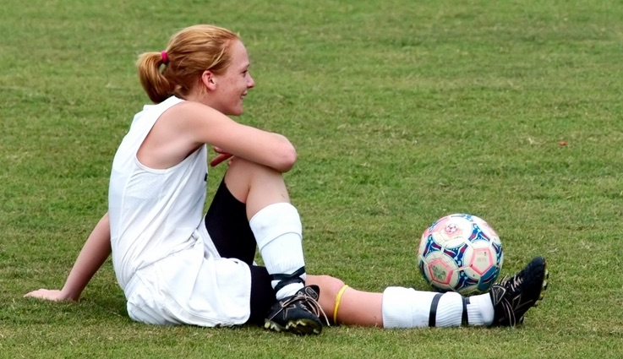
What Should I Do? 2. Summer Practices
Summer practices are unofficial and not required
BUT, CONSIDER:
New Coaches bring New ideas; understanding comes with effort
No Spring Club season; No Spring workouts, No June HS Preseason
If ever there was to be a summer that you should practice its this year
Essential for incoming Freshmen – you also have new team mates

Slide 11
What Should I do? Summer Practices
My desired schedule:
Monday Morning Fitness, Training Topic and SSG
Tuesday Late Afternoon Technical Skills & Team Discussion
Thursday Morning Fitness, Training Topic and SSG
Friday Late Afternoon: Full Field / Half Field Games
Weekend: Possible Friendlies or Preseason Tournament
5 weeks July 1st- August 2nd “Talent without working hard is nothing.” – Cristiano Ronaldo

Slide 12
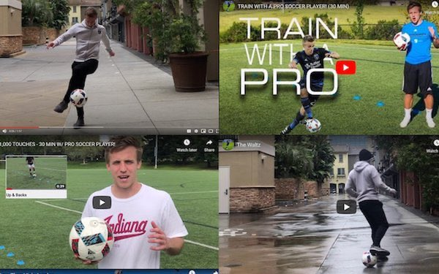
What Should I do? May & June
Every Zoom training that Cutters provides, check out Soccer Indiana too.
Any HOME BASED Workout you can find (Soccer oriented)
If unfit, running (build up your base) – Run-walk-run is better than Run
If fit, intensity training (cone runs, short rest – repeat . Change distances and recovery times)
Stadium Stairs when things are open. Swim !
THINGS WITH THE BALL! Juggle. Wall pass. Meulensteen Moves. Soccer Challenges. Tommy Thompson
https://www.facebook.com/AlameinFC/videos/264960801532715/
Pass and receive both feet, short and long distances. Maximize # of touches
Shoot on a goal. Have a KEEPER. Keep the ball moving. Dribble & shoot. Run & Shoot
Social distancing 6 feet makes it harder to add a defender (but do if you can)

Slide 13
What Should I do? Stay Connected
Struggling mentally and emotionally during this time in NORMAL
Players are “Sisters in Soccer” Help a freshman! @BHSN_s
Call me if you need help 812 325 6386
Players: Join GroupMe Lucy Martin can help
Parents: Join TeamSnap Kimberley Martin can help
Everyone: Join Twitter @bhsn_s This is what I will post on
Facebook: Closed group only, please Coaches must be invited

Slide 14
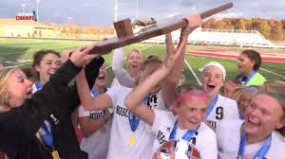
What’s My Vision for this Program?
Quality Coaching, There’s good coaching; and there’s bad.
Good Communication with Everyone
Playing the right way: Creative, Responsible, Enjoyable
Fun through soccer. Fitness through playing
Grow participation in the game. People want to watch us, too.
Player’s play; Coaches coach; Referee’s referee; Supporters support
Be the pre-eminent high school in local girl’s Soccer
Build up to be ready for sectionals; regionals; semi state

Slide 15
Expectation Setting
Most high school athletes four year career looks like
2 years as JV; 2 years as varsity
Transition from JV to varsity in either SOPH or JNR year
Exceptions for talented players who might be on varsity as FR
What pushes a player to varsity faster?
Outside involvement in the game:
2 (or 3) seasons each year, not one, means 1,000s of extra touches and dozens of extra games

Slide 16
Expectation Setting, BUT:
A team of talented freshmen will be beaten inmost games because opponents are older
SO:
Everything depends on participation rate: how many turn out to play?
In high participation schools, even talented FR may have a year on JV
Health and Strength of a sustainable program = Strength of JV team (not varsity)
We need to BUILD participation to BUILD a strong program
Everyone can help build for the future

Slide 17
What’s my Vision for this Program?
“In football (soccer), the result is an impostor. You can do things really, really well but not win. There’s something greater than the result, more lasting – a legacy.”
– Xavi (Spanish player 2000-14; World Cup Winner)

Slide 18
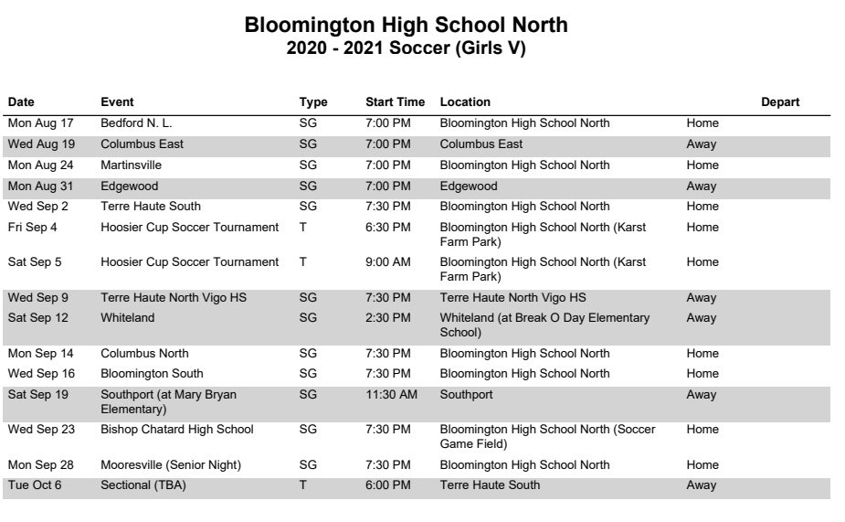

Slide 19
I Need Help!
Former BHSN Players who can Coach
BHSN Soccer Alumni Group. Organize Alumni Game this year
Build up the Booster Club. Do our share for Hoosier Cup
Create a Game day experience: Meet & Greet; Player’s playlist; Themes; Half time show
Away game nutrition and homework tutoring
Uniform stuff: if you want it, help organize it!
Be on-board; no drama
Tell me what I don’t know; I’m the oldest rookie HS coach in history
Forgiveness; we are all in this together

Slide 20
What Questions Do you Have?
If I can’t answer now, I will get back to you

Slide 21
Thank You!
Jeff Thomas
812 325 6386 (Text message is best)
thomasjbg@hotmail.com
“I’m lucky to be part of a team who help to make me look good, and they deserve as much of the credit for my success as I do for the hard work we have all put in on the training ground.”
– Lionel Messi

